Slide 1
The Olympic Games
Citius, Altius, Fortius
(faster, higher, stronger)

Slide 2
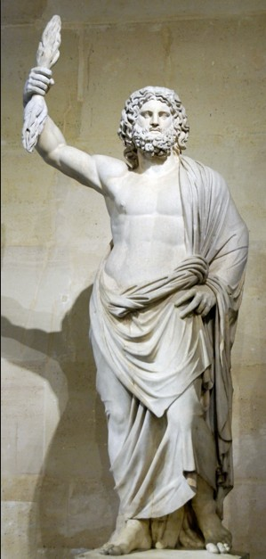
Zeus
In Greek mythology Zeus was ruler of both the Olympian gods and the human race.
Ancient Greeks held the Olympian Games every four years to celebrate and honor Zeus, the protector and ruler of mortals and the Olympian family of gods.

Slide 3
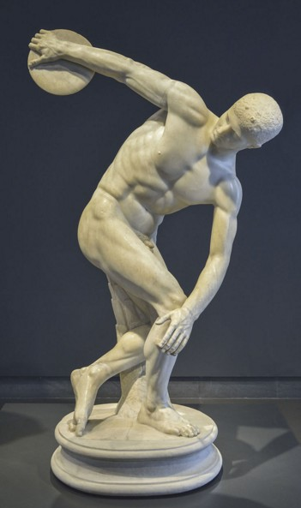
Ancient Olympic Games
The first Olympic Games were held in Greece in Olympia. First it was mentioned in 776 B.C. According to the legend, it was Heracles who first called the Games "Olympic" and established the custom of holding them every four years.

Slide 4
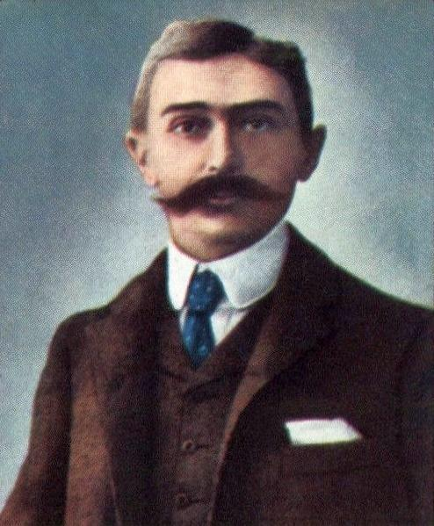
Modern Olympic Games
In the the 19 century Pierre de Coubertin gave the idea to held the Olympic Games again. To show the link with the past the games were organized in Greece, in the Panathenaic stadium in Athens, in 1896.
Pierre de Coubertin

Slide 5
Olympic Sports
The Olympic sports comprise all the sports contested in the Summer and Winter Olympic Games.
The Summer Olympics include 26 sports with 36 disciplines and about 300 events.
The Winter Olympics include 7 sports with 15 disciplines and about 80 events.

Slide 6
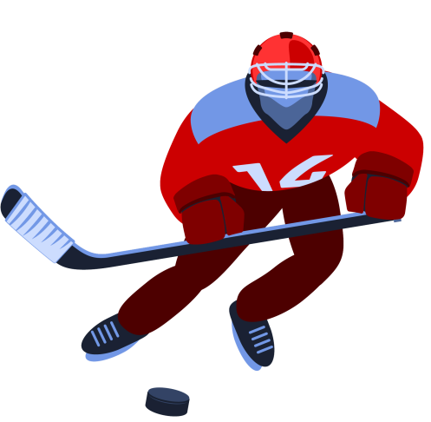
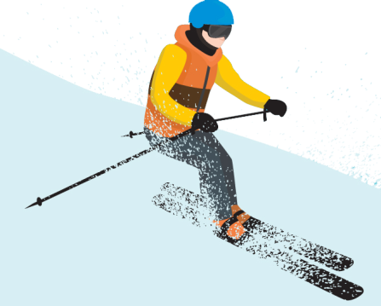
Winter Olympics
The Winter Olympic Games were first held as a separate competition in 1924 at Chamonix-Mont-Blanc, France.
From that time until 1992, they took place the same year as the Summer Games.

Slide 7
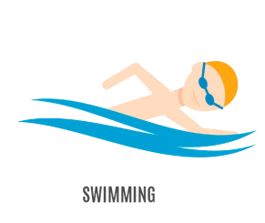
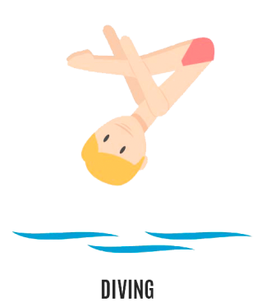
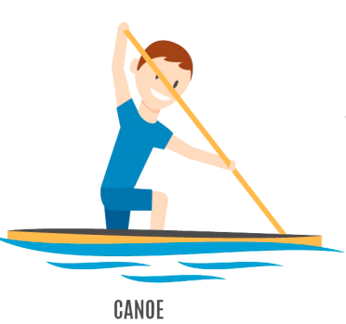
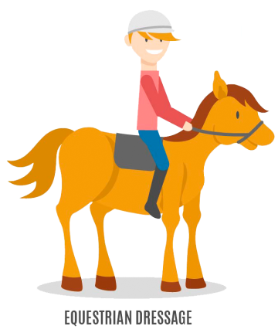
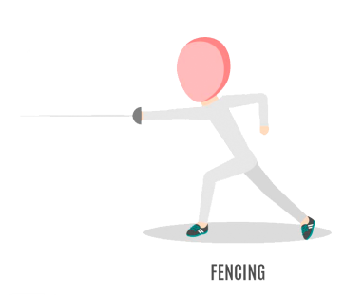
The Summer Games
The Summer Games are held during the summer season of the host country. They last for 16 days. Today, there are more than 270 events during the games. Over 15,000 athletes from 190 nations take part.

Slide 8
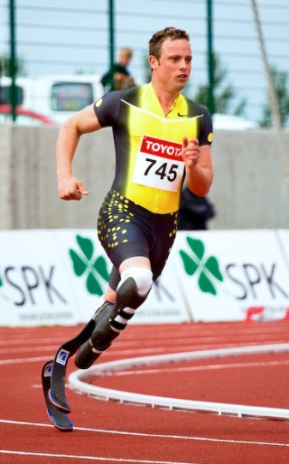
The Paralympic Games
The source of the term "Paralympic" is unclear. Probably it derives from the Greek preposition παρά, pará, para ("beside" or "alongside") and thus refers to a competition held in parallel with the Olympic Games. Or maybe it’s connected with the word “paraplegic”.
The symbol of the Paralympic Games is composed of three "agitos", coloured red, blue, and green, encircling a single point, on a white field.

Slide 9
Olympic Motto
Quicker, higher, stronger

Slide 10
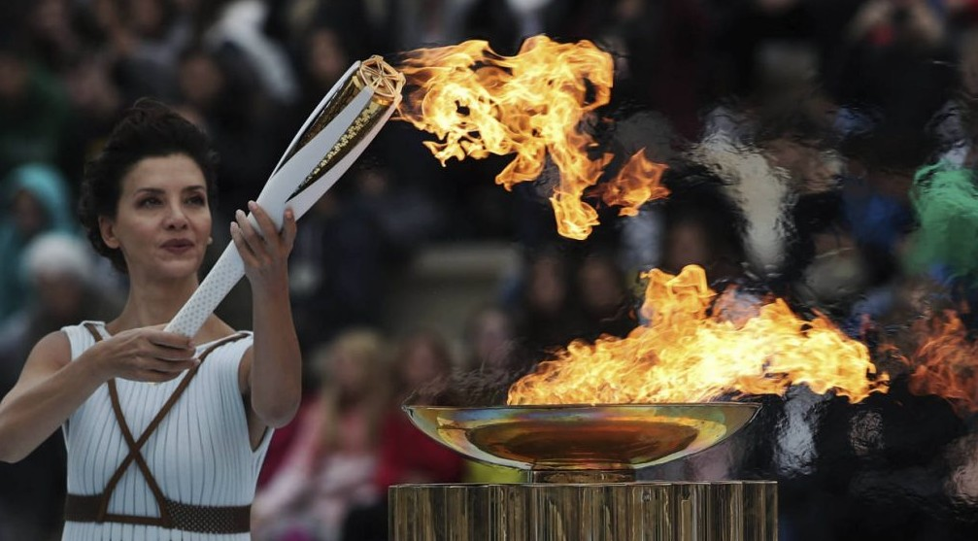
Olympic Fire
The Olympic flame is a symbol of spirit, knowledge and life. It is delivered from Olympia by a relay race to the site of games by the best sportsmen of the world. It burns from the opening ceremony until the end of the games.

Slide 11
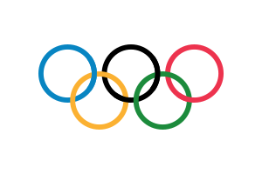
The Flag
The Olympic flag was presented on the summer Olympic Games in Antwerp in 1920. The Olympic flag is raised during the opening ceremony.

Slide 12
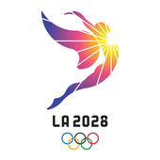
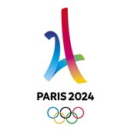
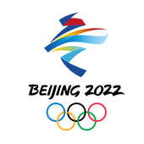
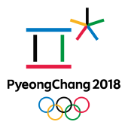
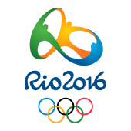
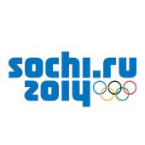
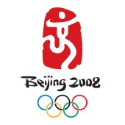
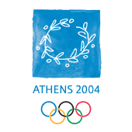
The Olympic Emblems
LA 2028
PARIS 2024
BEIJING 2022
TOKYO 2020
PYEONGCHANG 2018
RIO 2016
SOCHI 2014
LONDON 2012
VANCOUVER 2010
BEIJING 2008
TURIN 2006
ATHENS 2004

Slide 13
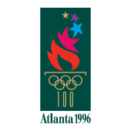
The Olympic Emblems
SALT LAKE CITY 2002
SYDNEY 2000
NAGANO 1998
ATLANTA 1996
LILLEHAMMER 1994
BARCELONA 1992
ALBERTVILLE 1992
CALGARY 1988
SEOUL 1988
SARAJEVO 1984
LOS ANGELES 1984
LAKE PLACID 1980

Slide 14
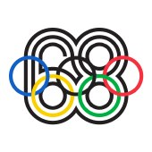
The Olympic Emblems
MOSCOW 1980
INNSBRUCK 1976
MONTREAL 1976
SAPPORO 1972
MUNICH 1972
GRENOBLE 1968
MEXICO 1968
INNSBRUCK 1964
TOKYO 1964
SQUAW VALLEY 1960
ROME 1960
CORTINA D'AMPEZZO 1956

Slide 15
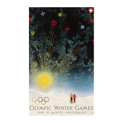
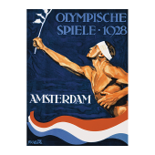
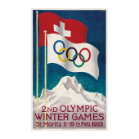
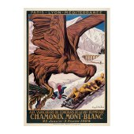
The Olympic Emblems
MELBOURNE -
STOCKHOLM 1956
OSLO 1952
HELSINKI 1952
ST. MORITZ 1948
LONDON 1948
GARMISCH-
PARTENKIRCHEN 1936
BERLIN 1936
LAKE PLACID 1932
LOS
ANGELES 1932
AMSTERDAM 1928
ST. MORITZ 1928
CHAMONIX 1924

Slide 16
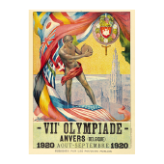
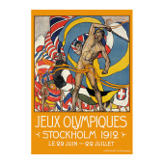
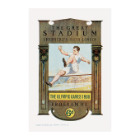
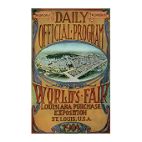
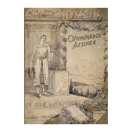
The Olympic Emblems
PARIS 1924
ANTWERP 1920
STOCKHOLM 1912
LONDON 1908
ST LOUIS 1904
PARIS 1900
ATHENS 1896

Slide 17
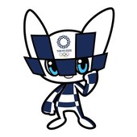
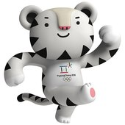
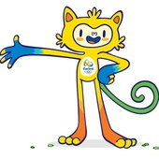
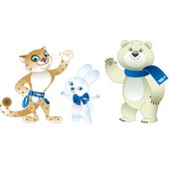
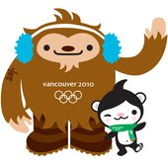
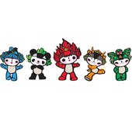
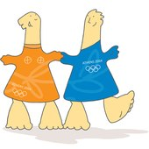
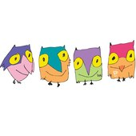
The Olympic Mascots
TOKYO 2020
PYEONGCHANG 2018
RIO 2016
SOCHI 2014
LONDON 2012
VANCOUVER 2010
BEIJING 2008
TURIN 2006
ATHENS 2004
SALT LAKE CITY 2002
SYDNEY 2000
NAGANO 1998

Slide 18
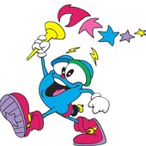
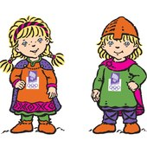
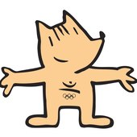
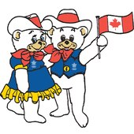
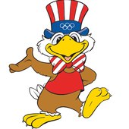
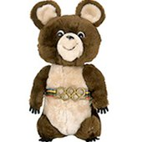
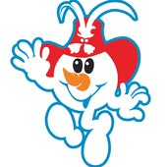
The Olympic Mascots
ATLANTA 1996
LILLEHAMMER 1994
ALBERTVILLE 1992
BARCELONA 1992
CALGARY 1988
SEOUL 1988
LOS ANGELES 1984
SARAJEVO 1984
MOSCOW 1980
LAKE PLACID 1980
INNSBRUCK 1976
MONTREAL 1976

Slide 19
The Olympic Mascots
MUNICH 1972
GRENOBLE 1968

Slide 20
Did you like this Presentation?
Please share it.
Thank you!
free-slides.net

